Slide 1
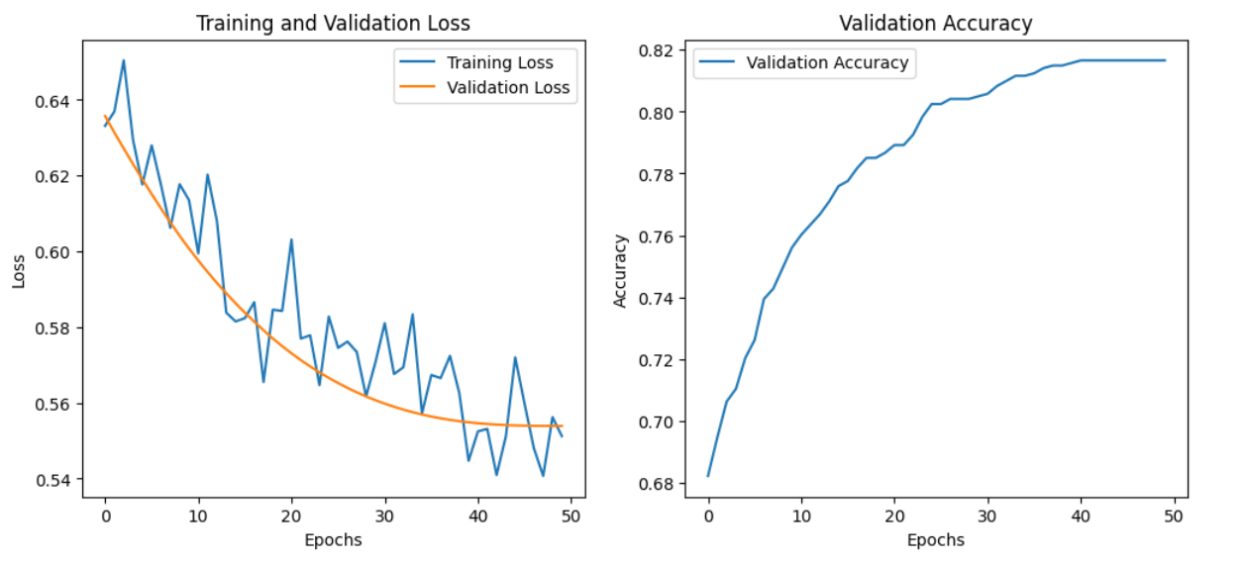
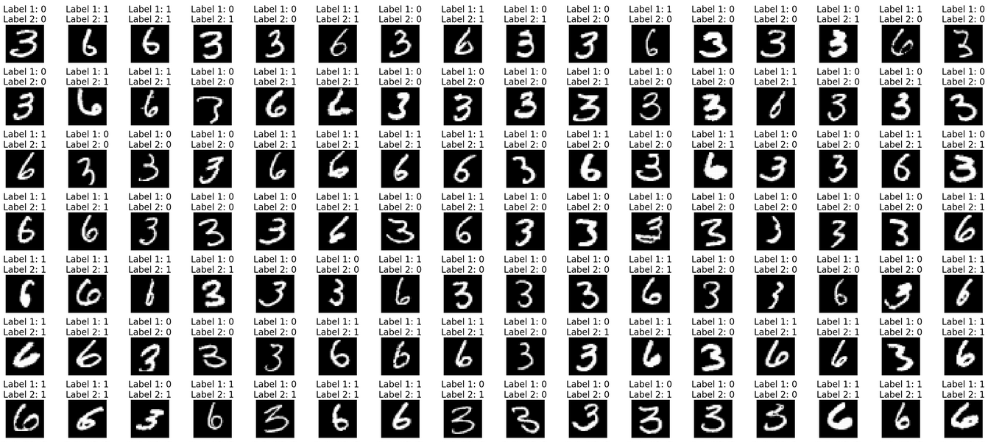
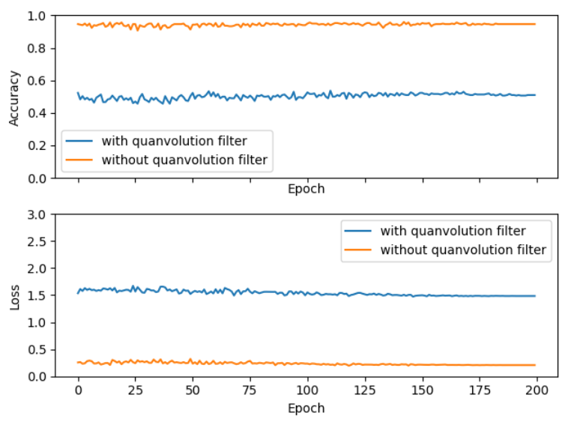
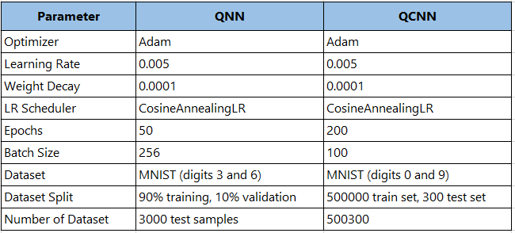
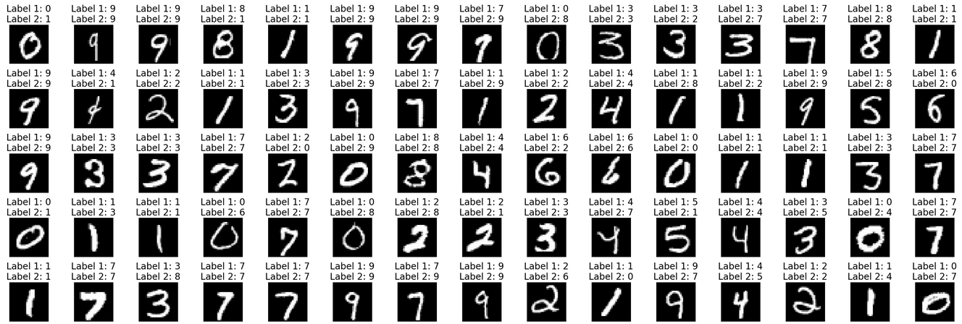
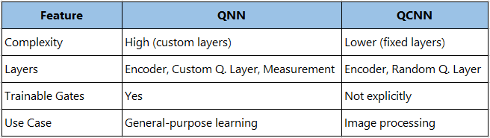
Comparing the Foundations: A Study of Two Basic Quantum Neural Networks
Lingyu Gong 23337765
EEP55C30-202324 ALGORITHMS FOR QUANTUM COMPUTING II
Objectives
All qubits are measured using the MeasureAll module with Pauli-Z observables for classical information extraction.
The circuit is processed using the Qiskit simulator, blending quantum and classical computing for practical testing.
To gain a thorough understanding of the components and structure of quantum neural networks.
To acquire the capability to implement and operate quantum neural networks effectively.
To stay informed about the current advancements and progress in the field of quantum neural networks.
To deeply comprehend the architecture and the profound implications of quantum neural networks.
Quantum Neural Network
Quantum Neural Networks is an advanced computing model that combines the concepts of quantum computing and neural networks.
Main Features:
QFCModel features a QLayer, representing a multi-layer, quantum circuit similar to classical neural networks.
It includes trainable quantum gates such as RX, RY, RZ, and CRX for adaptability.
Randomness is introduced by a random_layer, applying various quantum operations.
Data encoding is done via GeneralEncoder, crucial for transforming classical data into quantum format.
Quanvolution Neural Network
This method is like a conventional neural network's convolutional layer but leverages quantum computing to capture unique features beyond regular deep learning techniques.
Main Features:
Qubits: The filter uses 4 qubits to process image data.
Encoder: It employs a GeneralEncoder with ry gates to encode 4 pieces of input data onto the 4 qubits. The encoding translates input features into rotations on the Bloch sphere for each qubit.
Quantum Layer: A RandomLayer with 8 quantum operations is applied to introduce variability and expressiveness to the quantum circuit.
Measurement: The MeasureAll function performs a Pauli-Z measurement on all qubits, yielding expectation values that serve as the output.
Forward Pass: During the forward pass, the input image is partitioned into 2x2 patches. Each patch is processed through the quantum circuit, encoding and subsequent quantum operations.
Backend Processing: Depending on the use_qiskit flag, the quantum processing is performed using either the TorchQuantum or the Qiskit backend.
Conclusions

Slide 2
